Slide 1
http://cs.furman.edu/digitaldomain/instructors/tests/ch11testANS.htm

Slide 2
the major advantage of the stored programme type of computer is that the control sequence can be changed simply by modifying the programme.

Slide 3
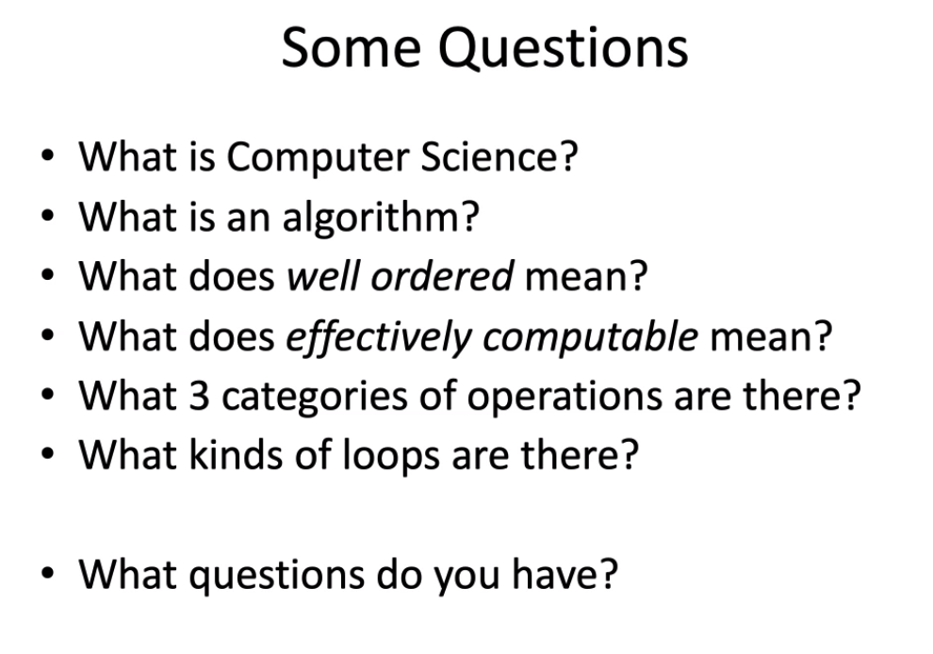

Slide 4
What is CS:
Computer science is the study of algorithms, including:
  Their formal and mathematical properties
  Their hardware realizations
  Their linguistic realizations
  Their applications
What is algorithm :
  A well-ordered collection of unambiguous and effectively computable operations that, when executed, produces a result and halts in a finite amount of time
Well-ordered means:
Well-ordered collection
  Upon completion of an operation, we always know which operation to do next

Slide 5
What is effectively computable means?
It must also be doable (effectively computable) by the computing agent
  Sequential operations
  Conditional operations
  Iterative operations

Slide 6

Pretest loop (while loop) execute the condition before the body(0 or more times loop)先看符不符合条件，符合才执行
Post-test loop(do while) check the condition after the body (1 or more time loop)

Slide 7
Formalize all of Mathematics （格式化所有数学公式）
23 problems
  When solved would be “the end of Mathematics” 解决时将是“数学的终结”

Slide 8
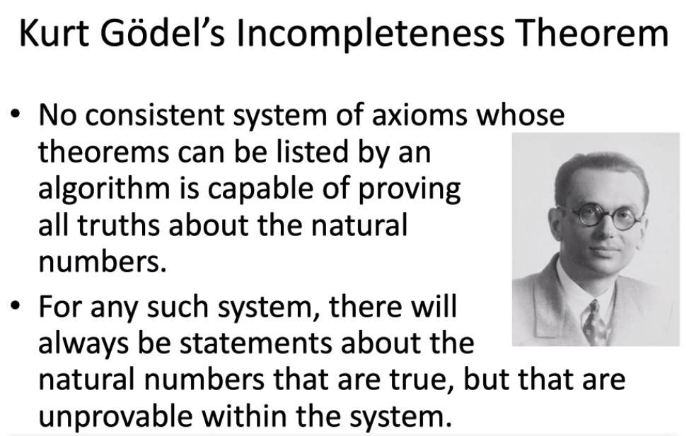
不完全性定理
无法解决那23 个问题
没有可以用算法列出定理的一致公理系统能够证明关于自然数的所有真相。
对于任何这样的系统，总会有关与自然数的陈述，陈述是正确的，但在系统内无法证明
(Kurt Gödel)

Slide 9
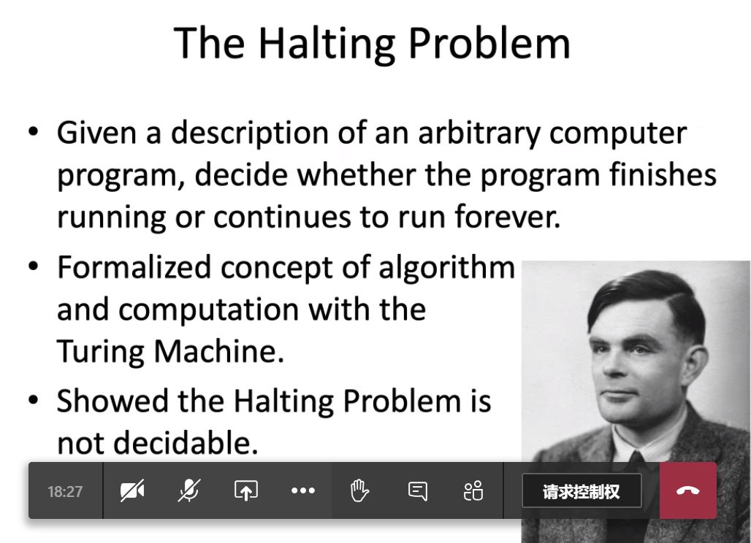
暂停
Turing:
The highest prize in computer science industry association for computing machinery.计算机科学工业协会CS最高奖
任意
Turing 机的算法和计算的形式化概念
停止问题无法被确定
(Alan Turing)

Slide 10
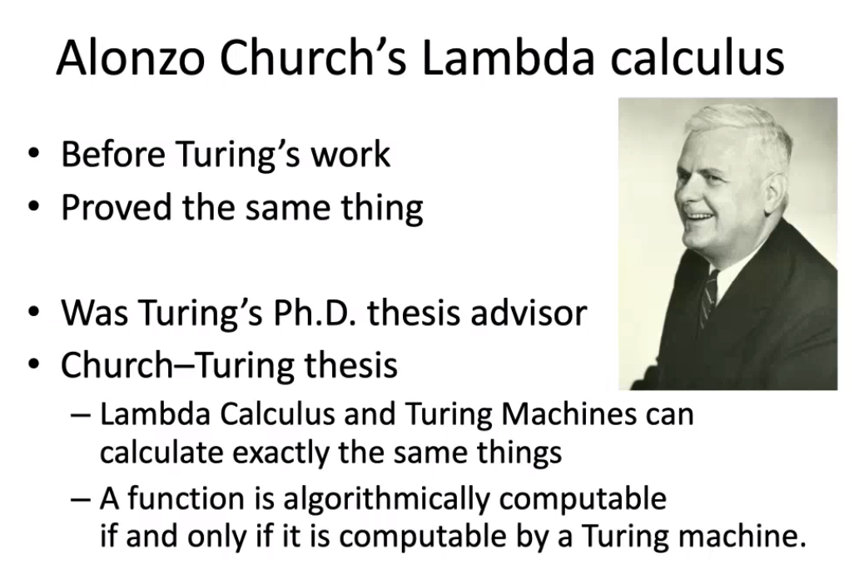
Turing 博士论文的导师
Church和Turing的论文
这不是第一个正式定义算法的人
最早的算法在7，8 世纪“Euclid
Lambda微积分和Turing机可以计算出相同的东西。
函数只能在由Turing机计算时才可以通过算法计算

Slide 11

Modern desktop system
GUI：Graphical User interface（图形用户界面）
WIMPy：电脑互动界面：
Commom components(成分）GUIs: windows，icons，menus，pointers
  Abstraction: different level of detail ,focus on high level, not details
  Top-down design: start with big picture, gradually elaborate parts

Slide 12
TASC(writing)
French(CLEO)
Math (Stem)
Computer course(Simpson)or Ashley Rankin

Slide 13
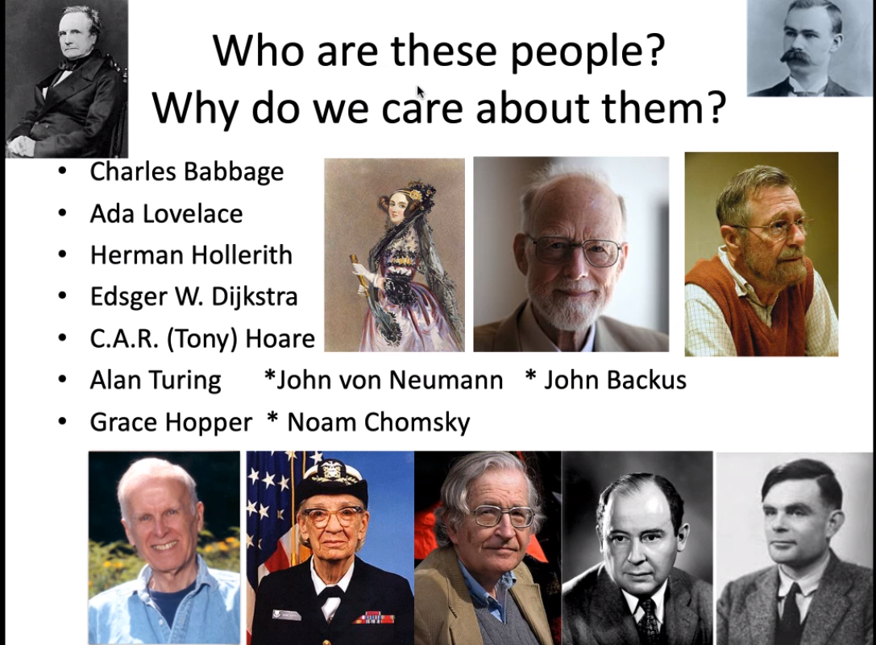

Slide 14
Charles Baggage:
Difference Engine designed and built in 1823
Analytical Engine: Designed but never built
Mechanical, programmable machine with parts that mirror that of a modern-day computer:
      Mill: Arithmetic/logic unit
      Store: Memory
      Operator: Processor
      Output Unit: Input/Output

Slide 15
The First programmer
She explained how to program Charles baggage’s machine
(Ada Lovelace)

Slide 16
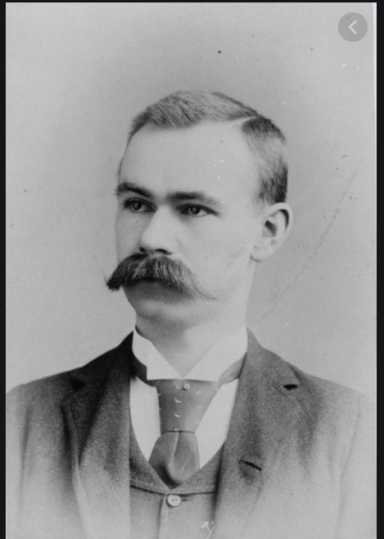
  Herman Hollerith (1880s onward)
  Designed and built programmable card-processing machines to read, tally, and sort data on punched cards for the U.S. Census Bureau
  Founded a company that became IBM in 1924
建立IBM公司

Slide 17
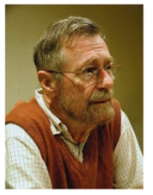
Edsger W. Dijkstra
Netherland （荷兰人）

Slide 18
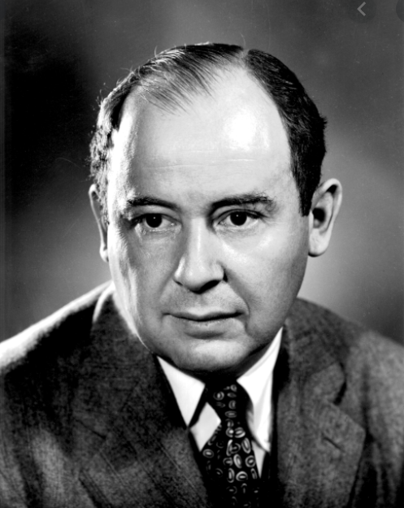
John Von Neumann
Store program in memory

Slide 19
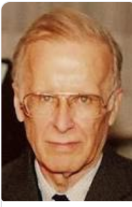
John Backus:
Developed fortran(formula translator)公式翻译程式语言 translate mathematical formulas into computer code

Slide 20
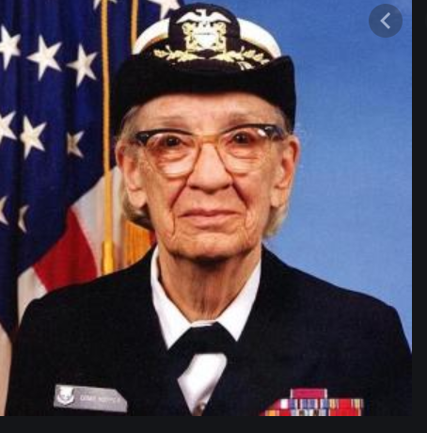
Grace Hopper
Developed language that eventually became cobol so after a few iterations and making improvements the language. She is very much associated with cobol language. She also first wrote compiler
开发了最终成为cobol的语言，因此经过几次迭代并对该语言进行了改进。 她与cobol(一种编程语言）有很多联系。 她还首先写了编译
Grace also famous for having the first computer bug in one of the notebook so you see some point. she has a notebook where she actually caught off that was in one of the relays on the mechines that she was working on and it was an actual physical computer bug.
Grace还因在其中一个笔记本拥有第一个计算机错误而闻名，因此您会发现一点。 她有一个笔记本，她实际上在那儿工作，这是她正在使用的机械上的一个继电器中，这是一个实际的物理计算机错误。

Slide 21
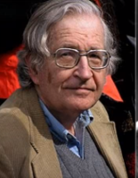
Noam Chomsky
Retired（退休） professor of linguistics（语言学）
It was MIT（麻省理工) for a while. now retired.
He still writing a lot of political topics so
退休了语言学教授
麻省理工学院已有一段时间了，现在退休了。
他仍然写很多政治话题

Slide 22
Blaise Pascal designed and built a mechanical calculator named the Pascaline (1642).
布莱斯·帕斯卡（Blaise Pascal）设计并制造了一种机械计算器，名为帕斯卡琳（1642）。

Slide 23
Joseph Jacquard designed an automated loom that used punched cards to create patterns (1801)
约瑟夫·提克（Joseph Jacquard）设计了一种自动织机，该织机使用打孔卡来制作图案（1801）

Slide 24
The secret rosies
Women doing calculating
The first electric computer
Focus on calculate the firing chart like where to point the weapons. Calculate those better.
Detect the airplanes before they get here
Bat bombs
Hard problem with building machine and programming
Recognition n. 识别，重视
Inversion (反向）
Partial result（部分结果）
Spreadsheet（电子表格)

Slide 25
What is the control unit do?
It is the third part that goes and grabs the instructions from memory and it cause them to be executed
Store the result
Fetch the instruction
decode
Op code
Operation code
ALU is what actually dose the computation itself. It takes input that are provided by the control unit an actually calculates the result and then the control unit store the result.
What is the three step in Von Neumann cycle?
Get instruction from memory. We have to figure it out and then we actually have to do it.
What are the technical terms for those?
Decoding
We have to decode the instruction.
When we decode it then we can actually perform it. This called execution.
What part of a machine language command tells us which operation needs to be performed?
Op code

Slide 26
What are the 4 main categories of commands that we could have?
1. Moving date / Data transfer, e.g., move data from memory to register
2. Arithmetic, e.g., add, but also AND
3. Comparison: compare two values
4. Branch: change to a nonsequential instruction
  Branching allows for conditional and loop forms
  E.g., JUMPLT a = If previous comparison of A and B found A < B, then jump to instruction at address a

Slide 27
Feature 特色，特征
Instruction register is used to store the instruction that we are executing now.
How do we know where to grab the instruction in memory?
There is a register hold the address of the next instruction. It called program counter.
If we are working with a system that control unit always keeps track of the next instruction to operate.
When we are ready to execute that. We fetch the value at that location and stored in the instruction register. Then we start to interpret(翻译） decode and op code. Is there the address components as well.

Slide 28
GPU：graphical card
Graphical processing unit
GUP is run single instruction multiple data(SIMD) they are all running the same instructions but operate on their own copies of data.
So graphics cards then could are perfect for this because to calcite the color for each dot is basically the same algorithms being re it just need different data to be working on.

Slide 29
RAM: stored on a computer chips（RAM储存在计算机芯片上)
SSD: solid state diver 固态硬盘: eg CD、DVD
Your BIOS(basic input output system )not stored on RAM 装在ROM中
Eprom(Erasable programmable read-only memory) 可擦写可编程只读存储器

Slide 30
the major advantage of the stored programme type of computer is that the control sequence can be changed simply by modifying the programme.

